Slide 1

Givematic
Graph Hack - 2022
Luca, Conner, and Andrew

Slide 2

only
$34,000
per adoption

Slide 3
More Donations != More Impact
For every $1 you donate, ASPCA spends:
Administrative Overhead: $0.40
Advertising: $0.38
ACTUAL VALUE TO THE CAUSE: $0.22

Slide 4
Givematic – Transparent Donation/Spending Platform
Leveraging the Polygon Blockchain (only on Mumbai testnet)
Deploying using Figment’s DataHub
With Coinbase Wallet integration using RainbowKit

Slide 5
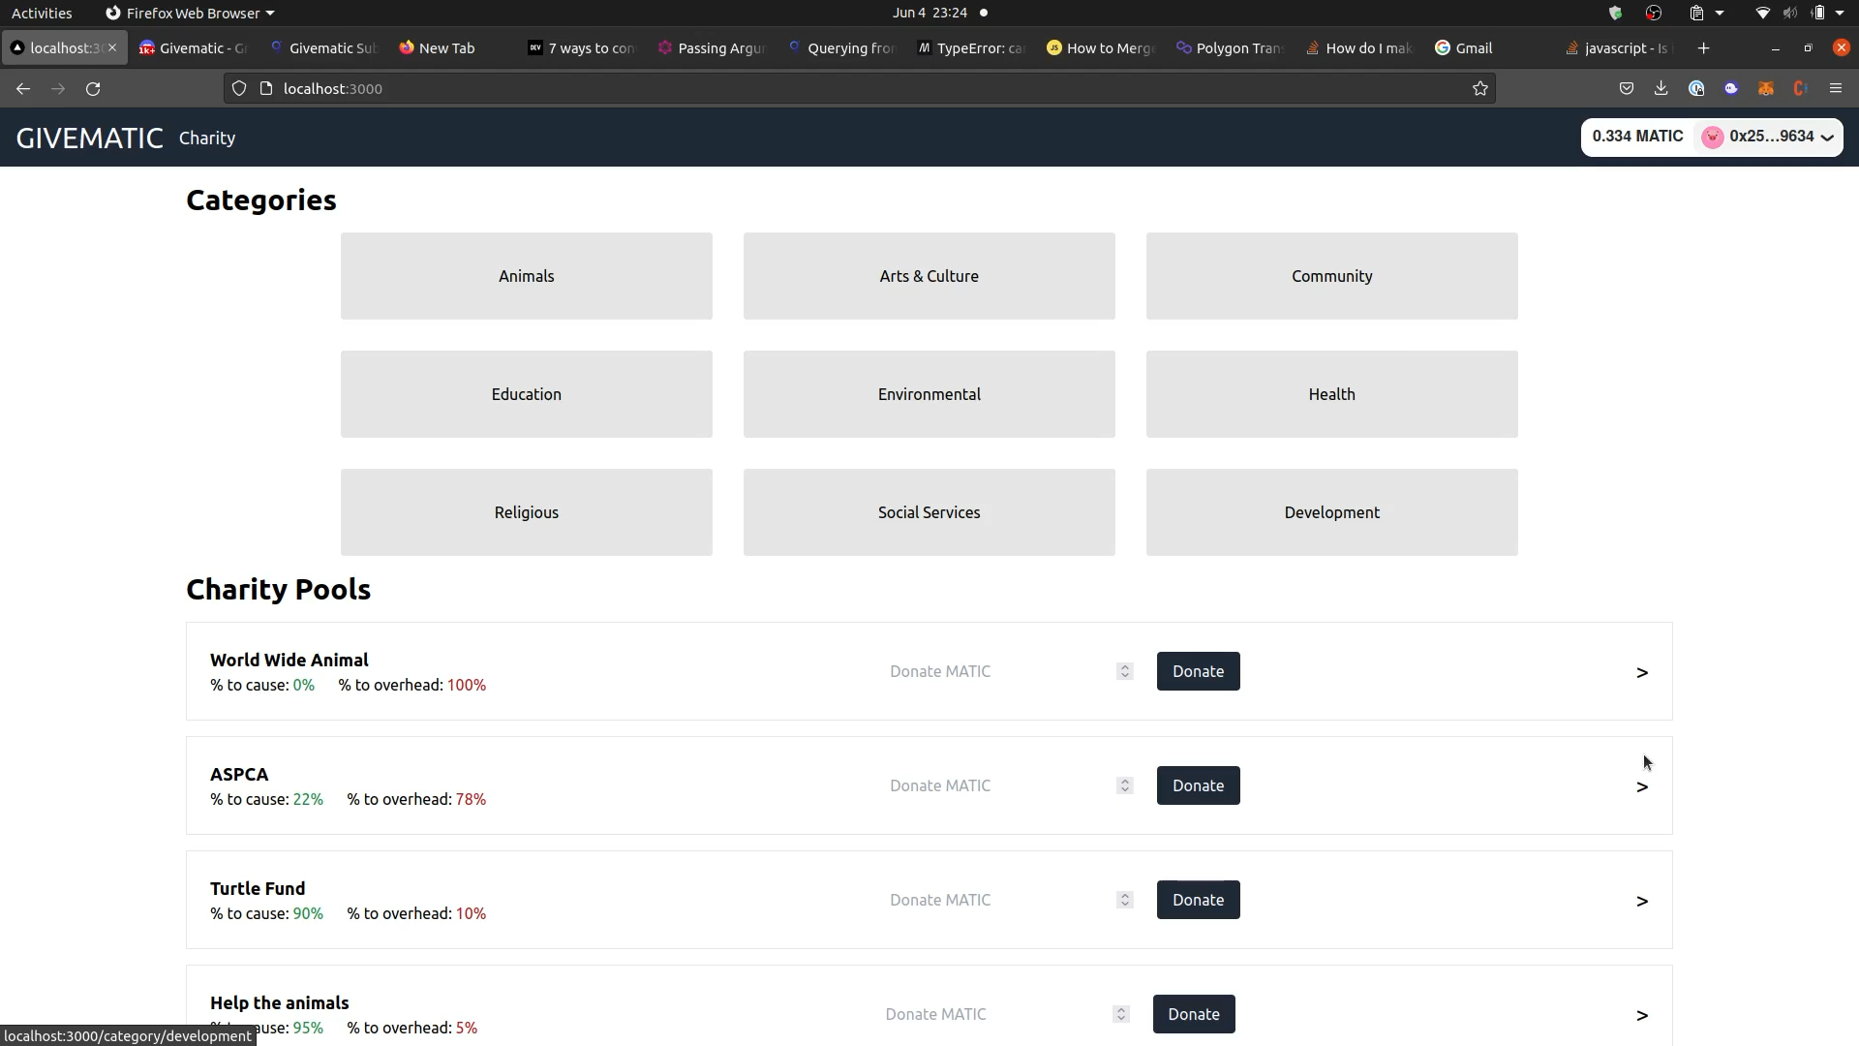
Philanthropist View

Slide 6
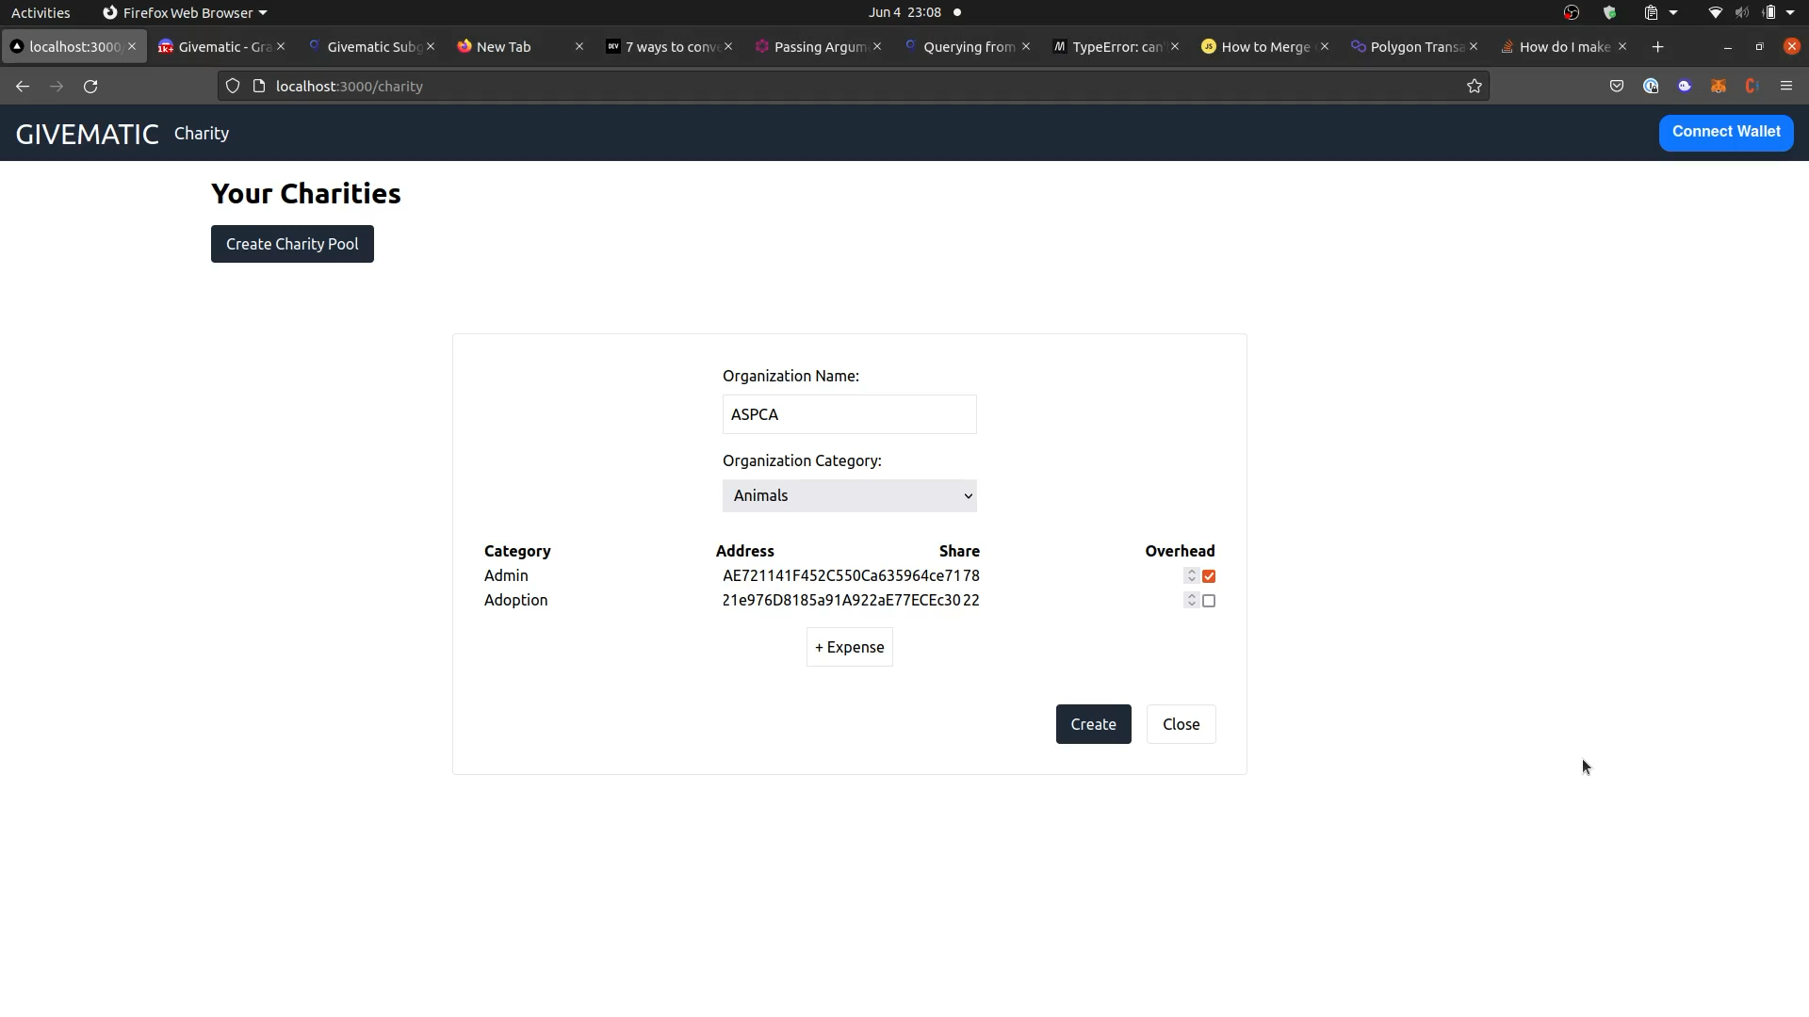
Charity/Organization View

Slide 7
Other Benefits:
Organizations can test multiple configurations of where they wanted to deploy
Can adjust allocations as world events happen
Can easily provide more detailed options for specific donation purposes
E.g., quickly solicit funding to help Ukraine specific efforts from a global support fund
E.g., Dogs only instead of all pets
Will naturally incentivize smaller organization structures (less overhead)

Slide 8
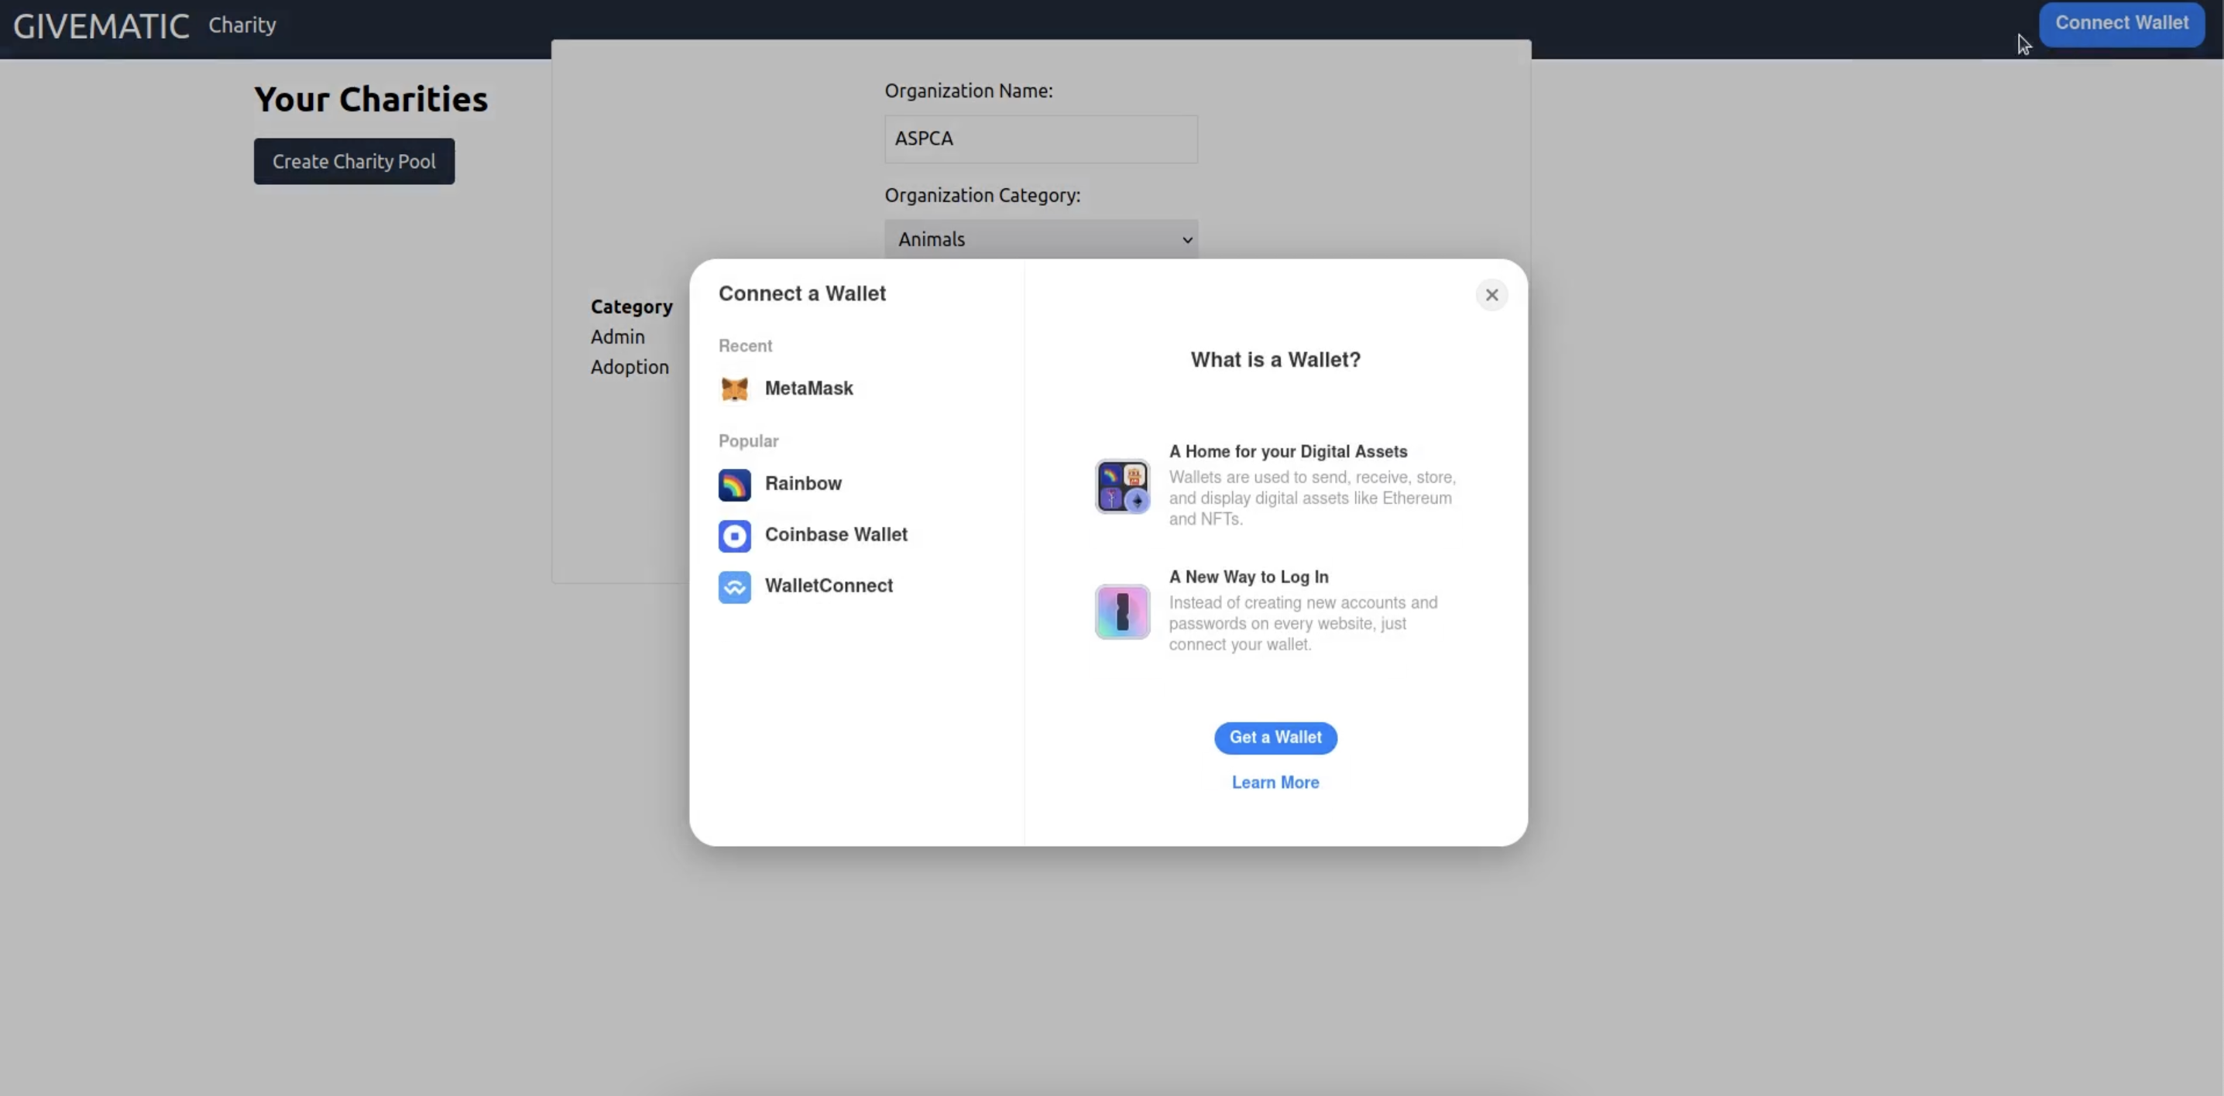
Coinbase Wallet Integration through RainbowKit:
Enabled philanthropists to connect Coinbase Wallet using RainbowKit

Slide 9
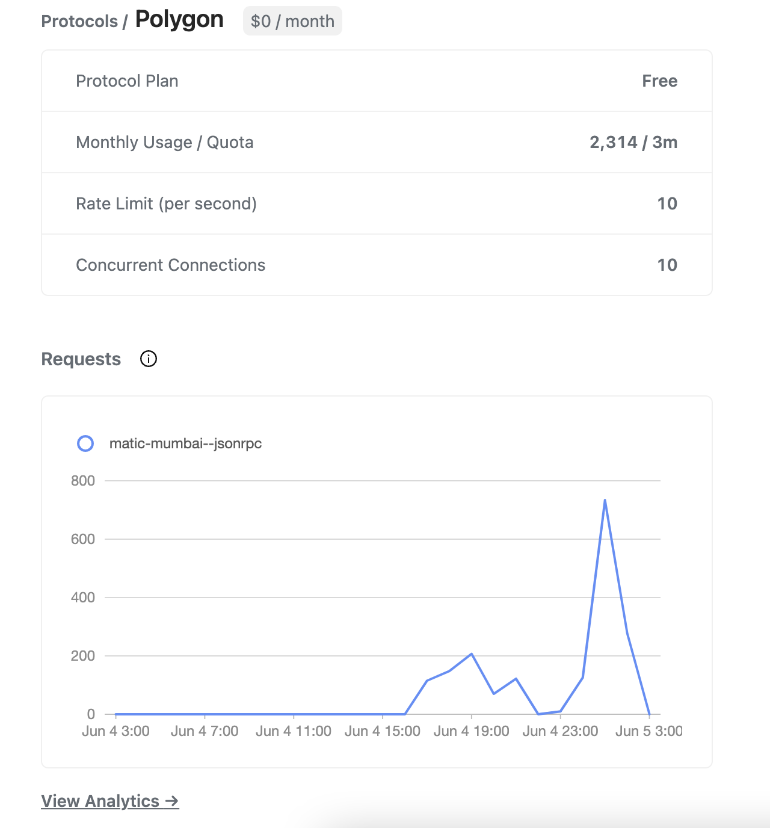
Figment DataHub integration
Used Datahub for Polygon nodes
Mumbai testnet
Attempted to connect our subgraph through the DataHub UI, but it is not supported
Hosted-Service ID: QmXVGRAQZU2SBqqcPp1iuyGy5Y9EUEM913GAFRvuQLwmJn

Slide 10
Bonus Content
Comments on Coinbase Android Wallet App

Slide 11
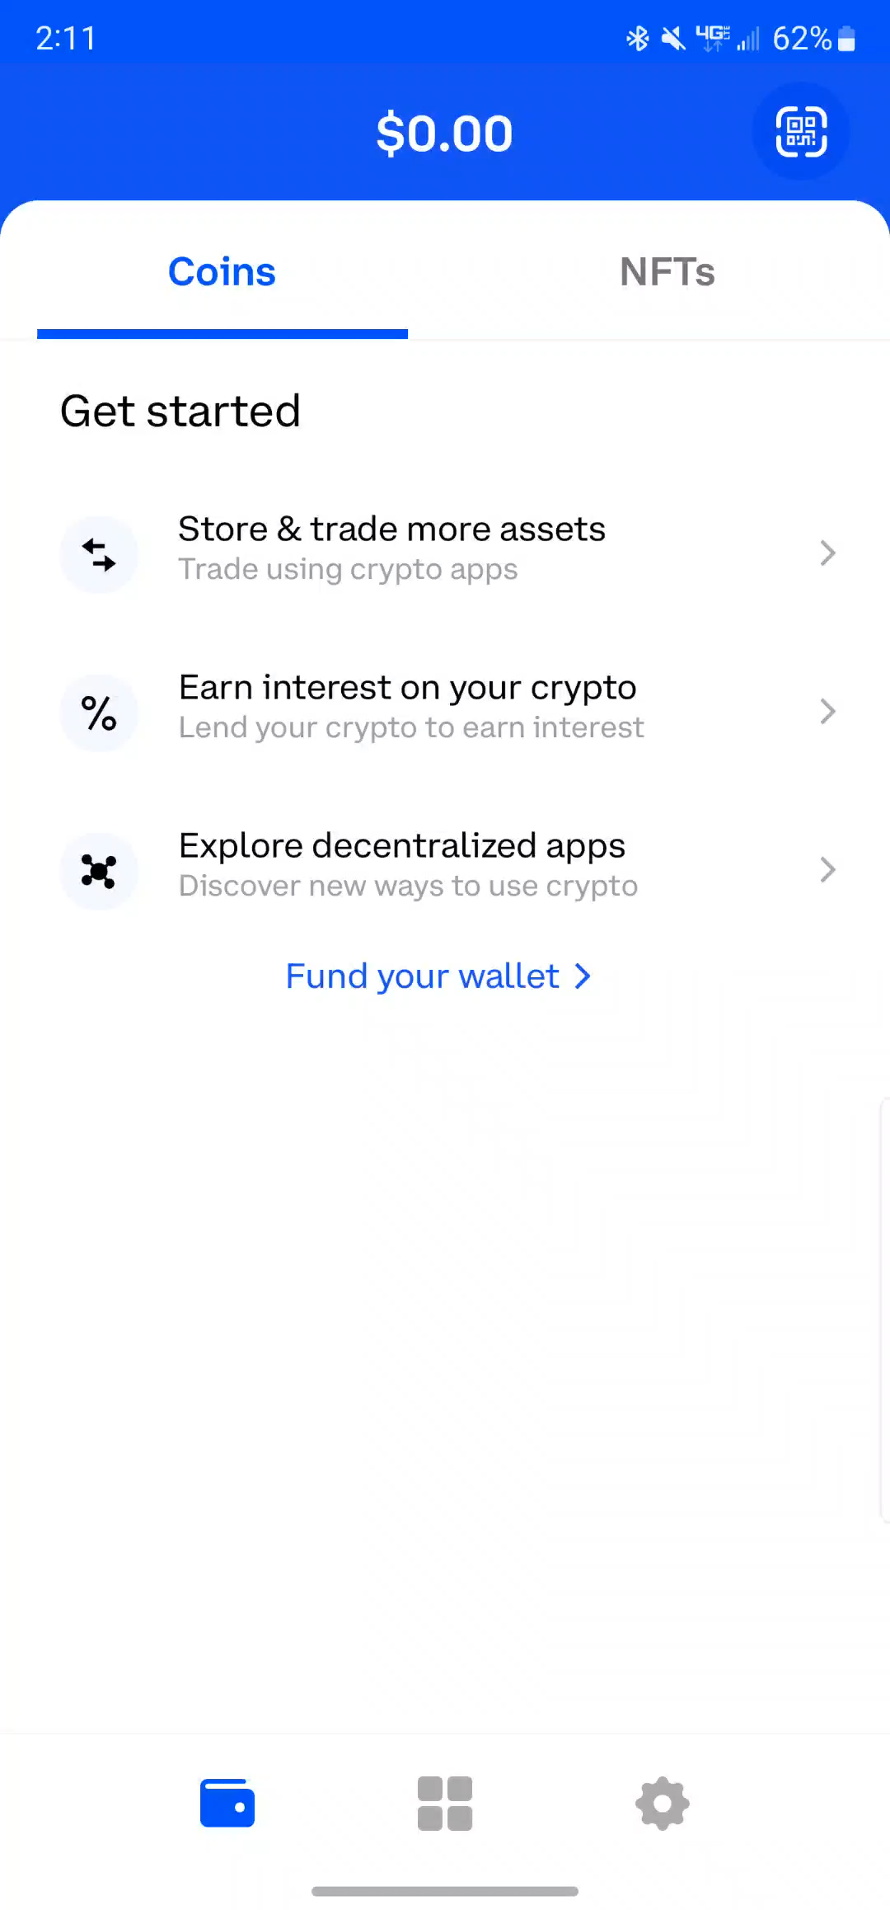
Coinbase Wallet (Android) issues (1-3)
1. Screenshot policy
2. Password checks
3. Missing UI elements
4. No Network Warnings (Ethereum only)

Slide 12
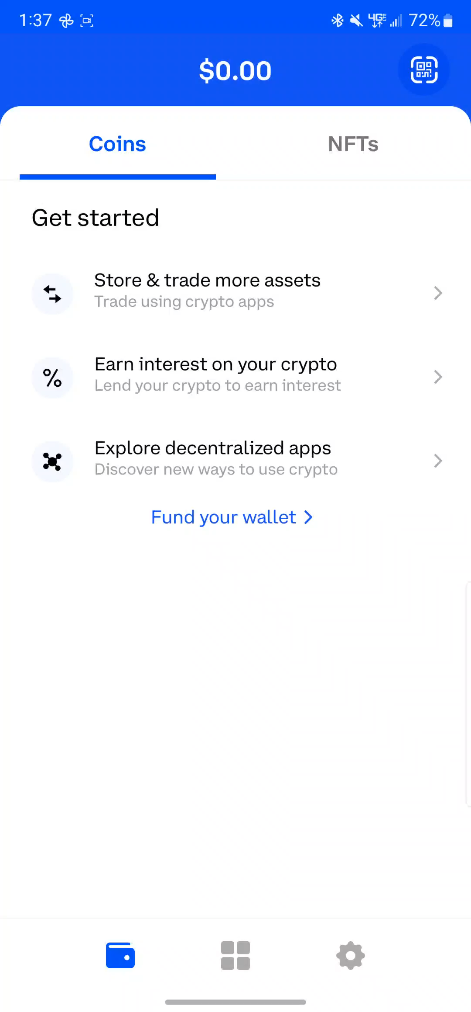
Coinbase Wallet (Android) issues (4)
1. Screenshot policy
2. Password checks
3. Missing UI elements
4. No Network Warnings (Ethereum only)

Slide 13
THANK YOU

